Slide 1
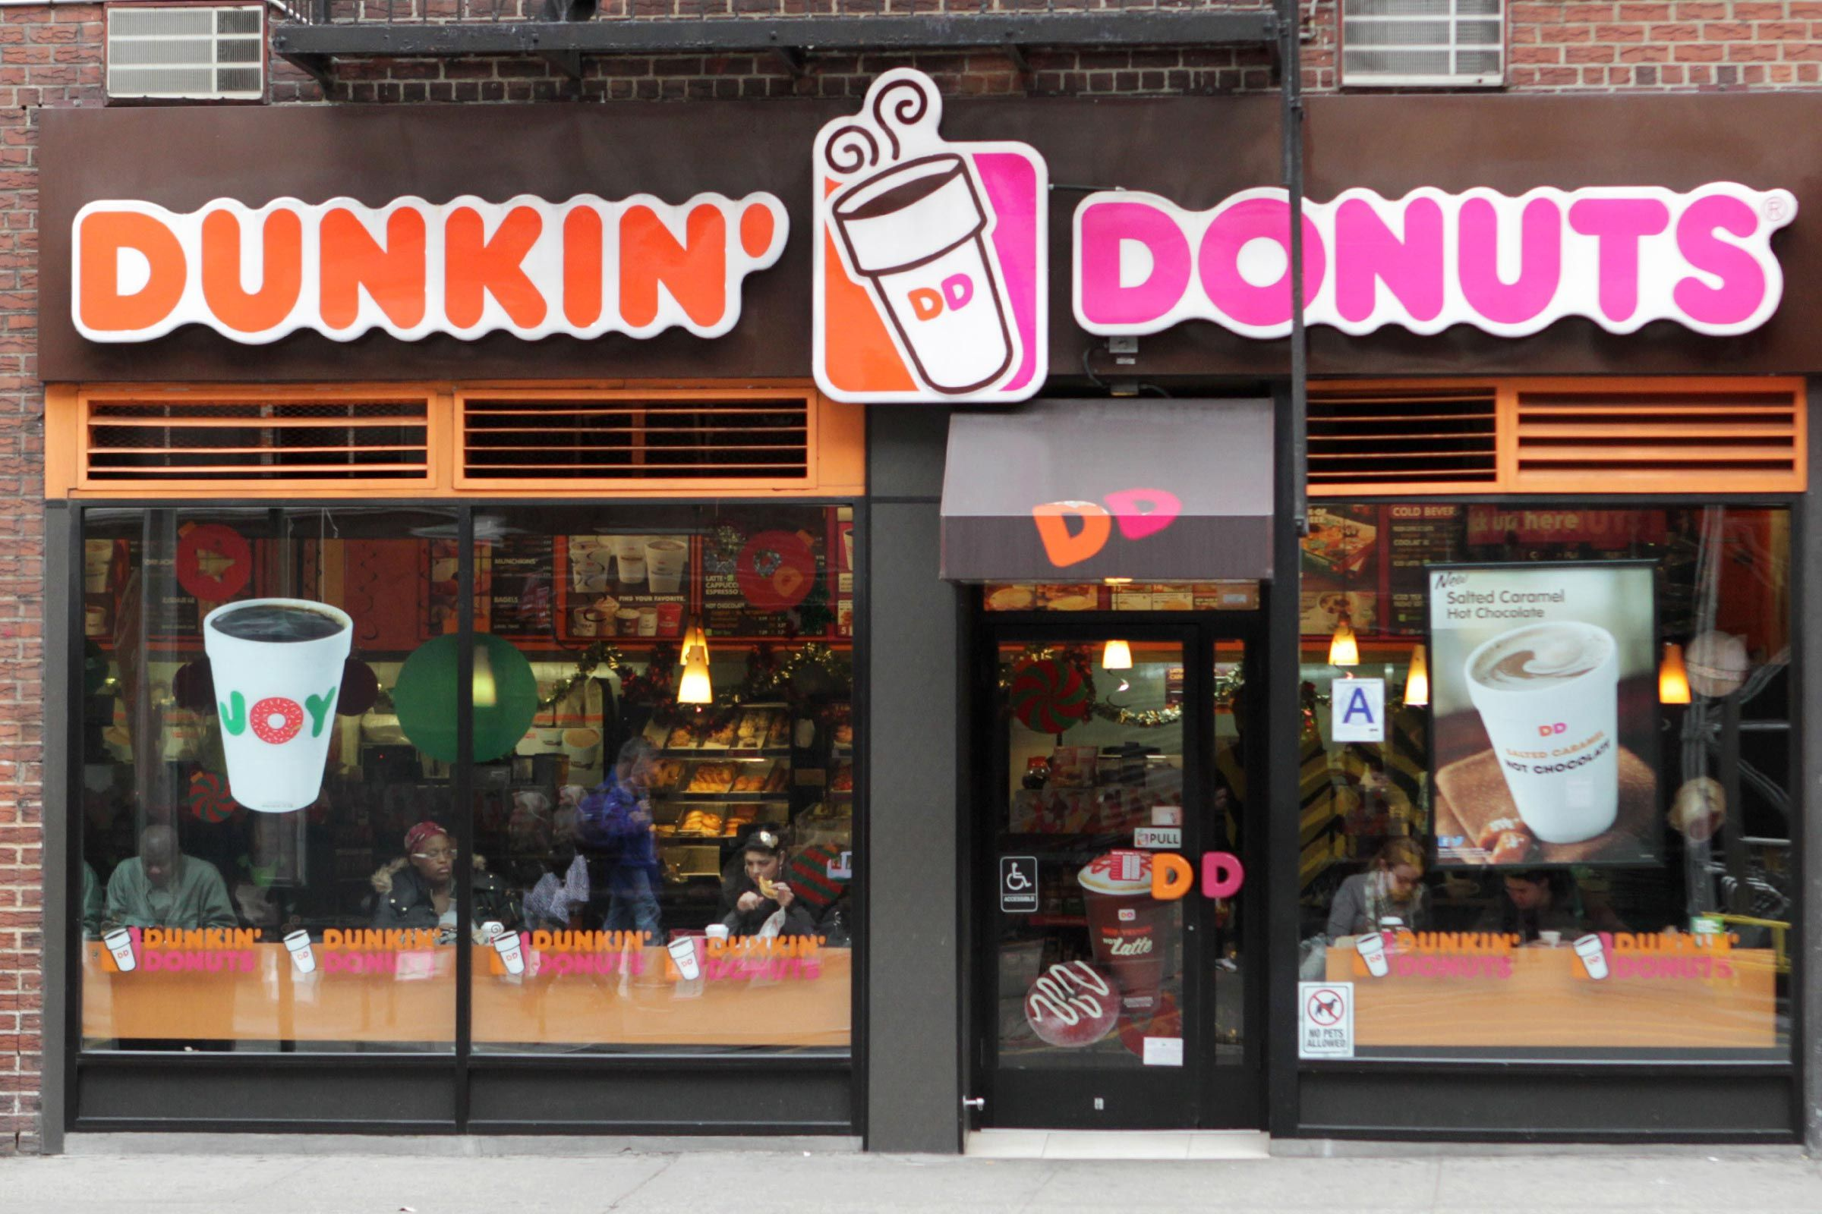

Slide 2


Slide 3
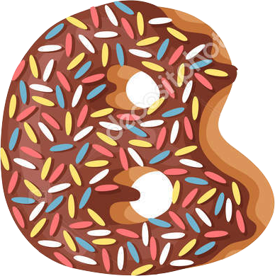






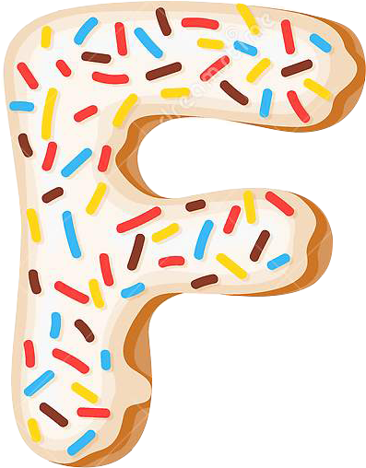

Slide 4
I like donuts ……

Slide 5
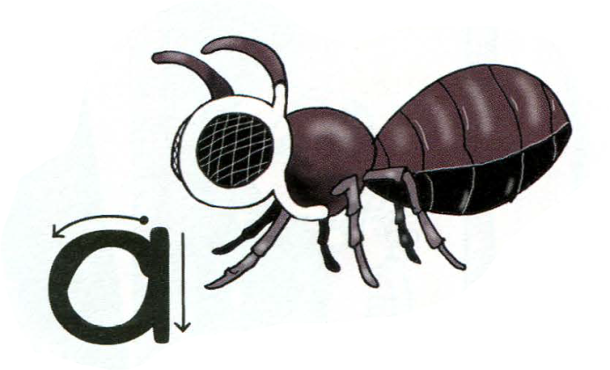
An ant
An – один, любой
Ant – муравей
A
a
an ant

Slide 6
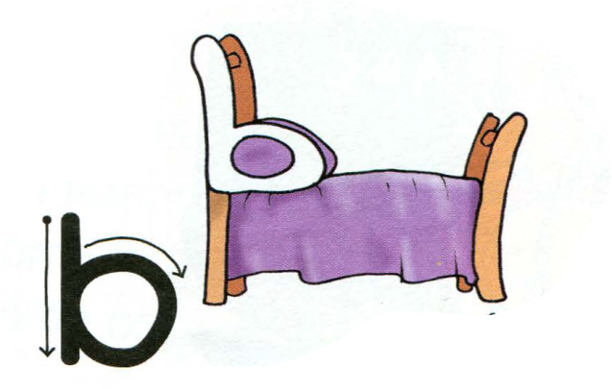
A bed
A – один, любой
Bed – кровать
B
b
a bed

Slide 7
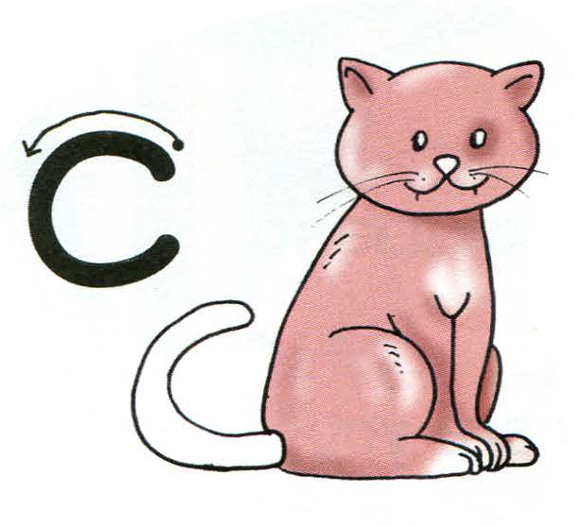
A cat
A cat – кот
С
с
a cat

Slide 8
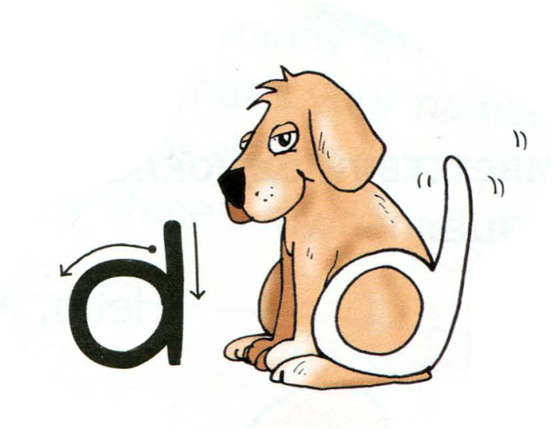
A dog
A dog – собака
D
d
a dog

Slide 9

An egg
An egg – яйцо
E
e
an egg

Slide 10
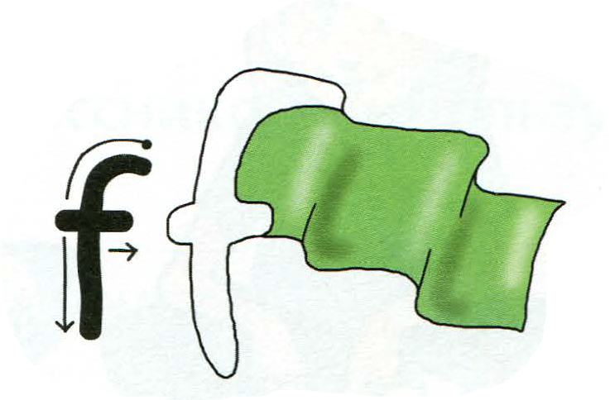
A flag
A flag – флаг
F
f
a flag

Slide 11
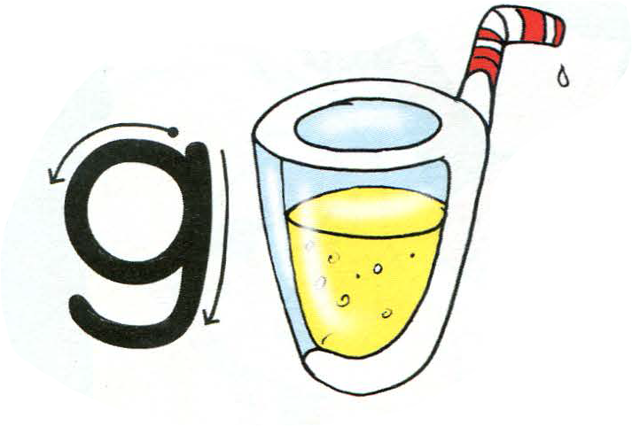
A glass
A glass – стакан
G
g
a glass

Slide 12
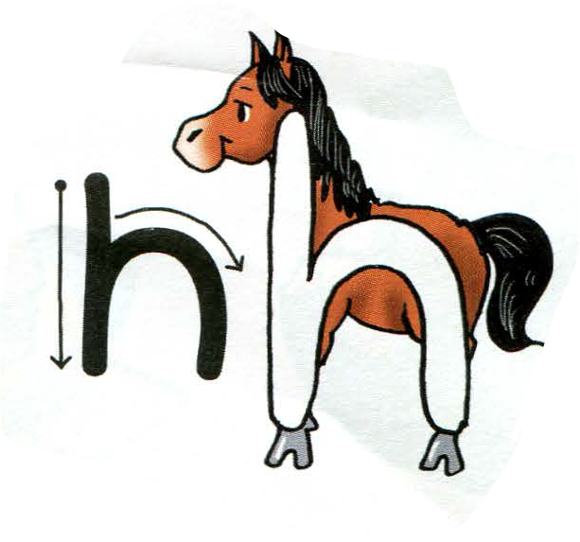
A horse
A horse – лошадь
Н
h
a horse

Slide 13



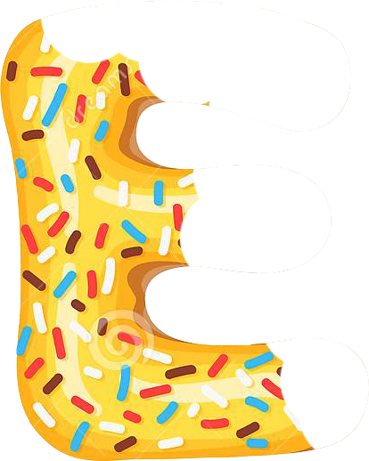
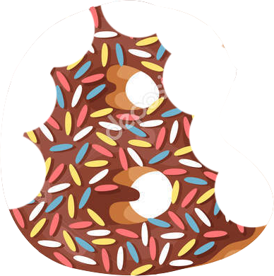




Slide 14
A glass
An ant
A cat
A dog
An egg
A bed
A flag
A horse

Slide 16
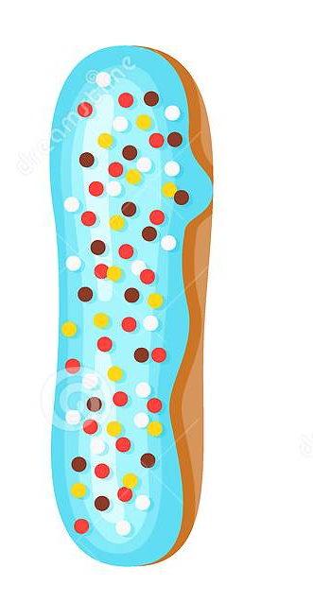

ink
I
i
ink

Slide 17


A jug
J
j
A jug

Slide 18
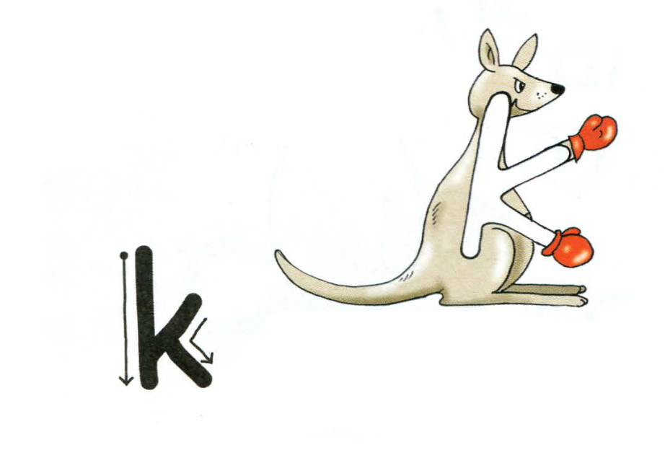
K
k
a kangaroo

Slide 19
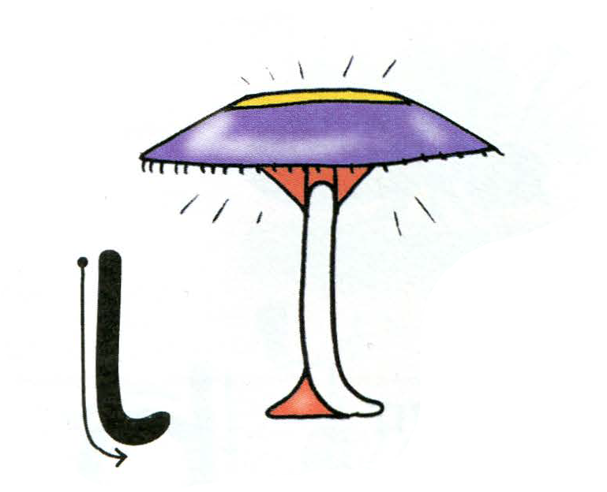
L
l
A lamp

Slide 20
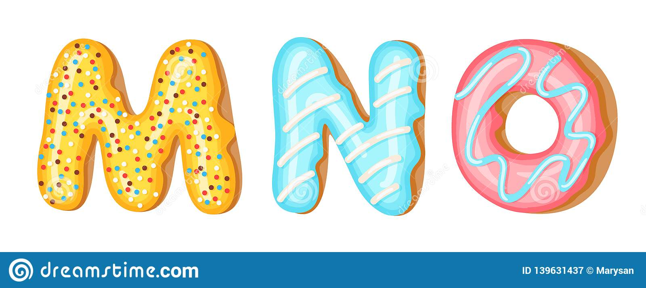
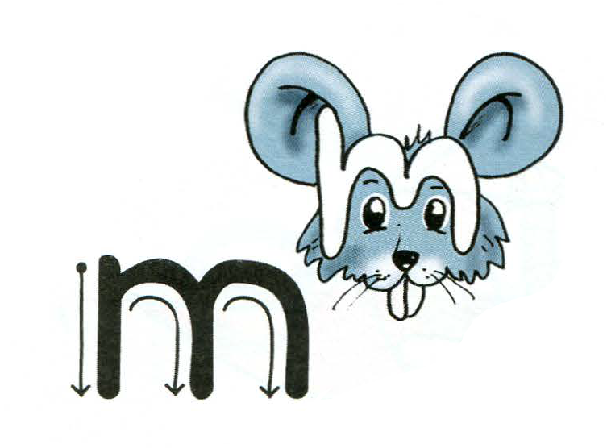
M
m
A mouse

Slide 21
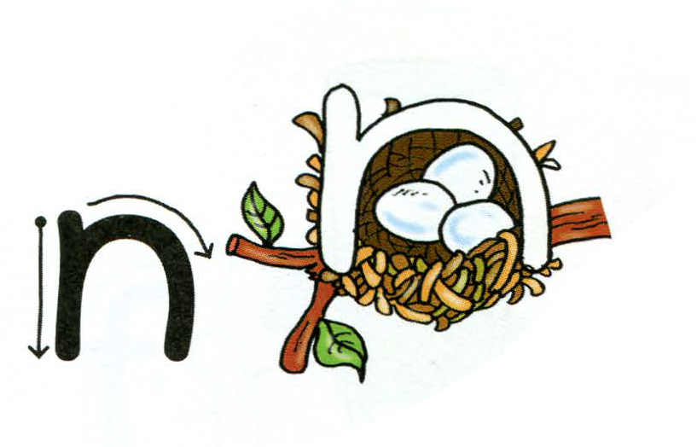
N
n
A nest

Slide 22
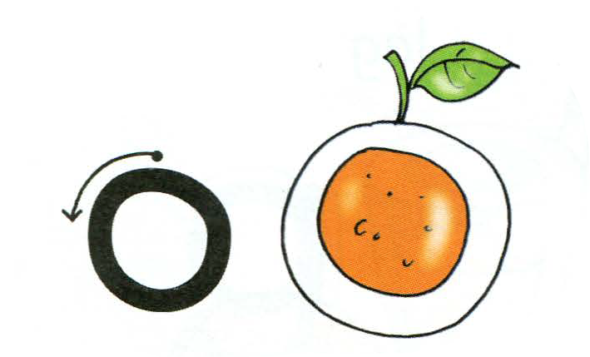
O
o
An orange

Slide 23


P
p
A pin

Slide 24
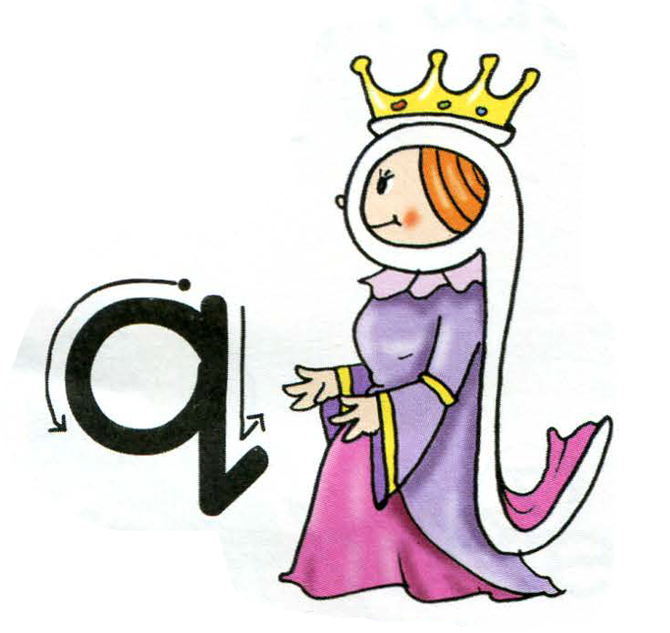
Q
q
A queen

Slide 25
Aa Bb Cc Dd
Ee Ff Gg Hh
Ii Jj Kk Ll
Mm Nn Oo
Pp Qq

Slide 26
A lamp
A jug
An orange
A nest
A mouse
A kangaroo
A pin
A queen
An orange

Slide 27





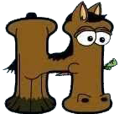



Slide 28
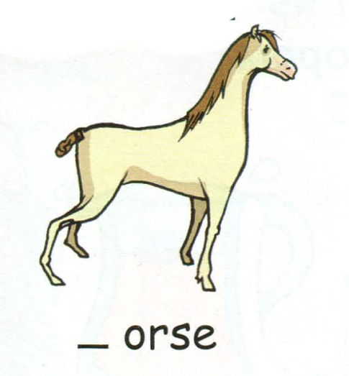
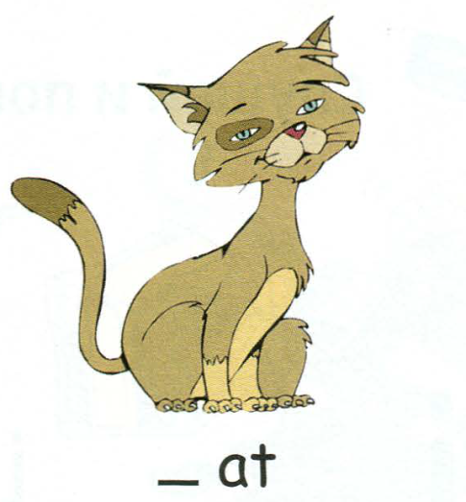
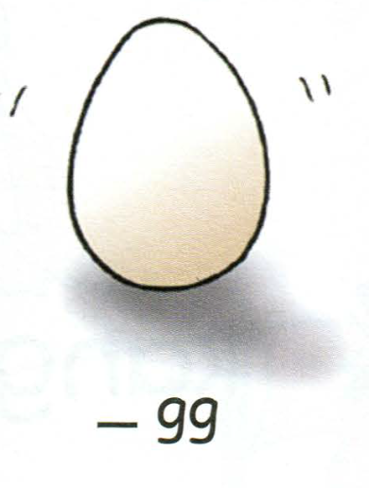
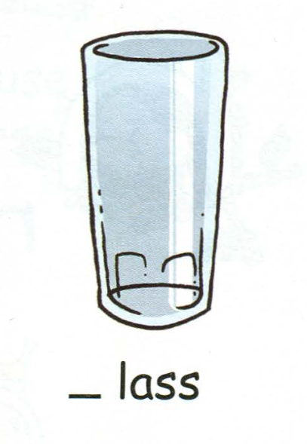
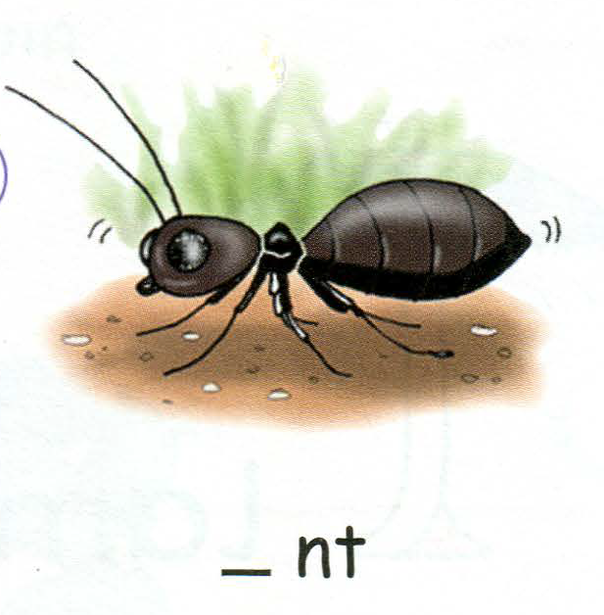
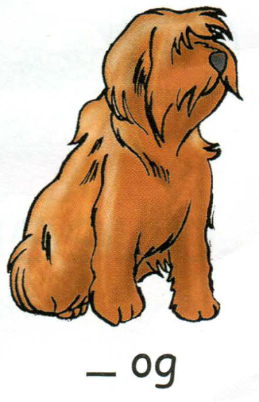
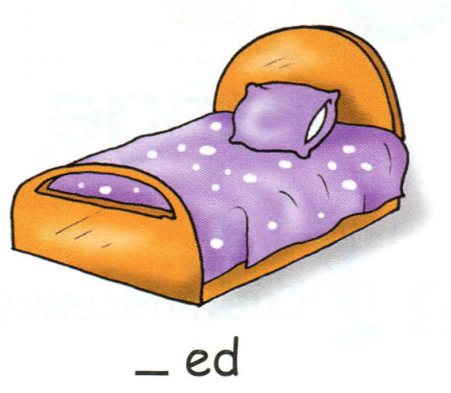
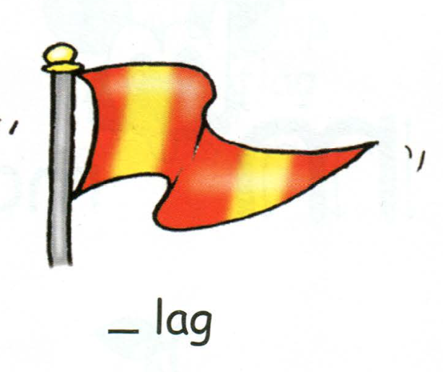
H
C
E
G
A
F
D
B

Slide 29

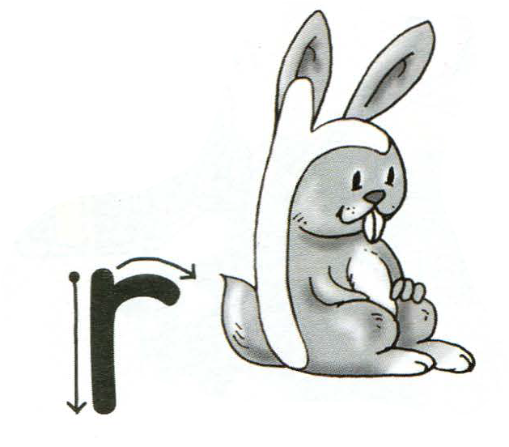
A rabbit
R
r
A rabbit

Slide 30

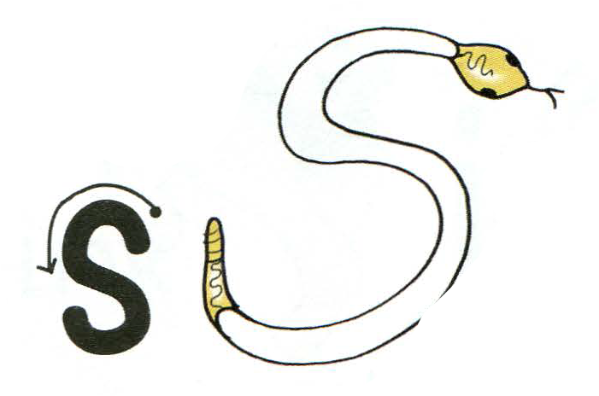
A snake
S
s
A snake

Slide 31


A tree
T
t
A tree

Slide 32


An umbrella
U
u
An umbrella

Slide 33

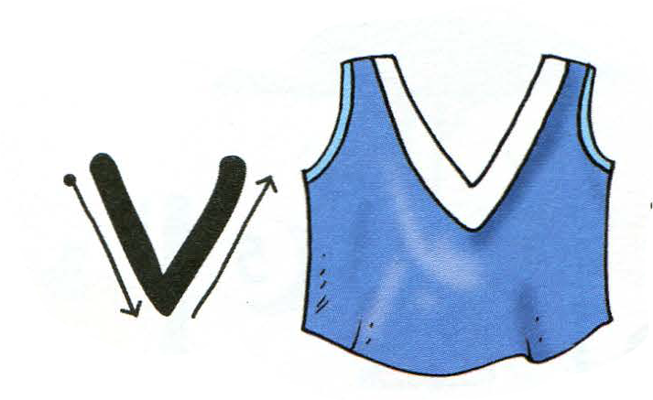
A vest
V
v
A vest

Slide 34

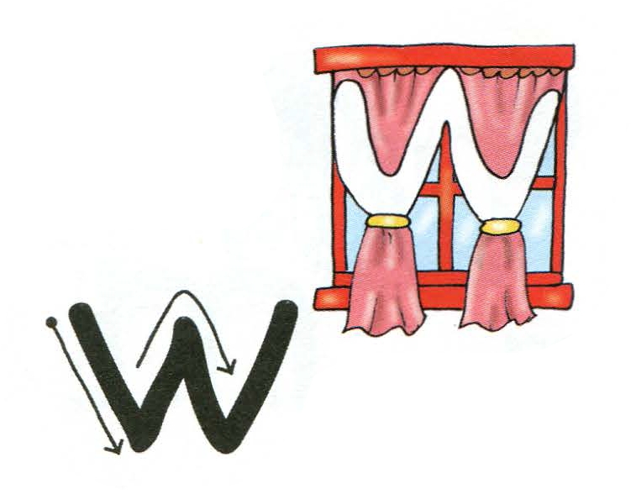
A window
W
w
A window

Slide 35


A box
X
x
A box

Slide 36


A yacht
Y
y
A yacht

Slide 37


A zip
Z
z
A zip

